Slide 1
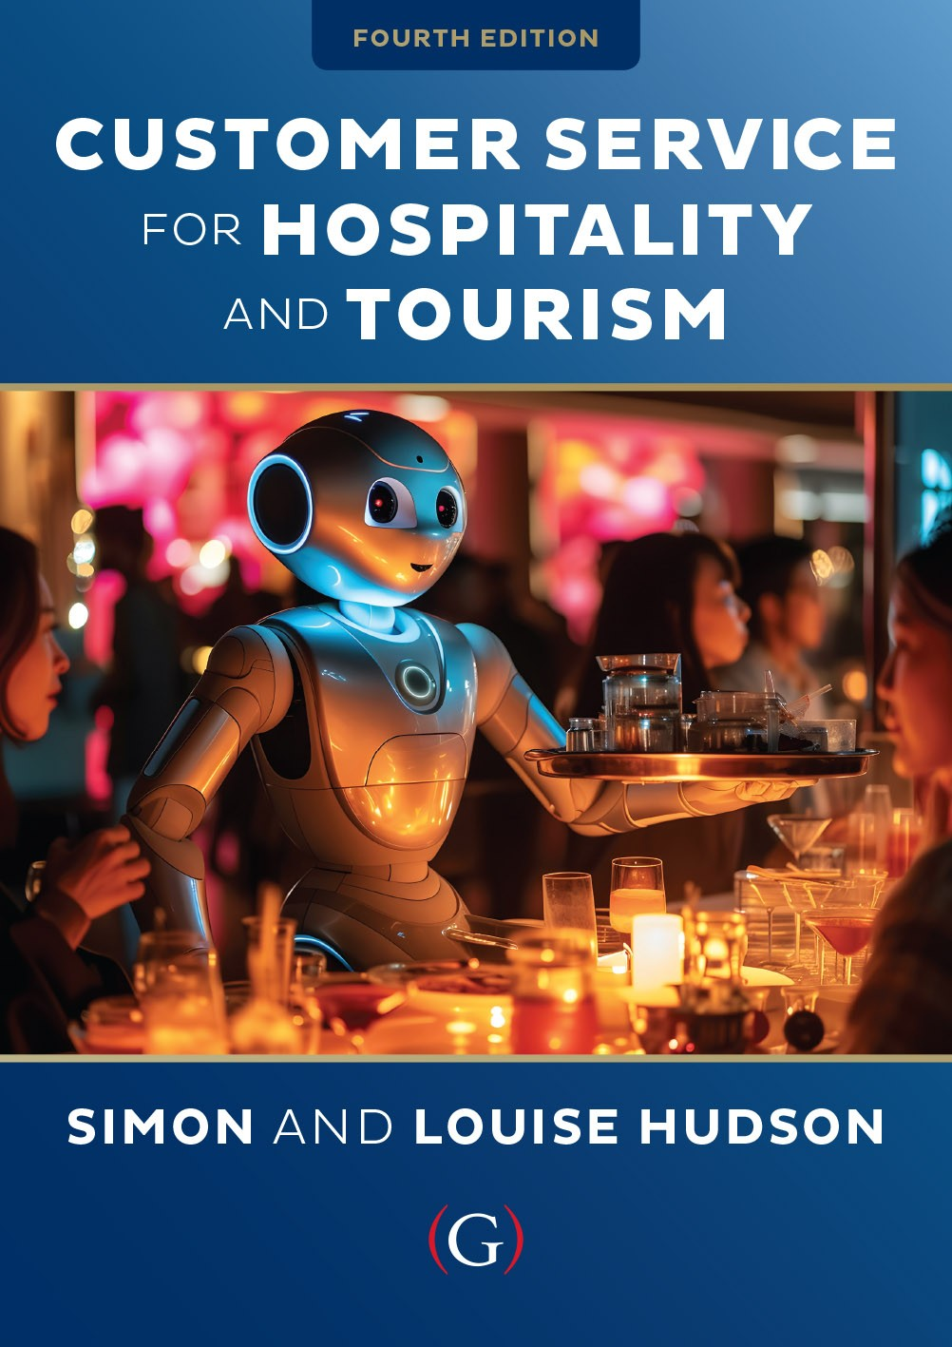
Chapter 8
Providing customer service through the servicescape

Slide 2
Topics Covered
Elements of the servicescape
The strategic role of the servicescape
Developing servicescapes
Themed servicescapes
The effects of servicescapes on consumer behaviour
Waiting line strategies
Intelligent servicescapes

Slide 3
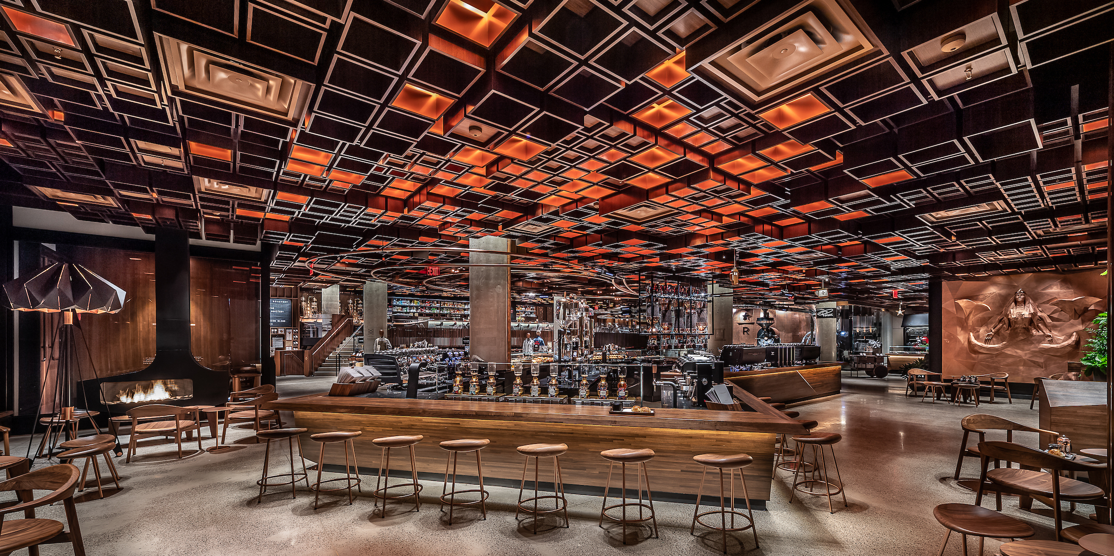
‘At Your Service’ Spotlight:
Hospitality Starbucks-style
‘Third place’ - a social, yet personal environment ….where people connect with others and reconnect with themselves.
Themes inspired by Italian espresso bars
  Inviting, comfortable, compelling servicescapes
  Sensory pleasures and ambiance
  Italian terminology
Customer focused
  First names on paper cups
  Free WiFi for work, social networking
  Meeting place, community hub
Long-term brand integrity
  Espresso machines replaced
  Modified menu items
  Slowed expansion, new products

Slide 4
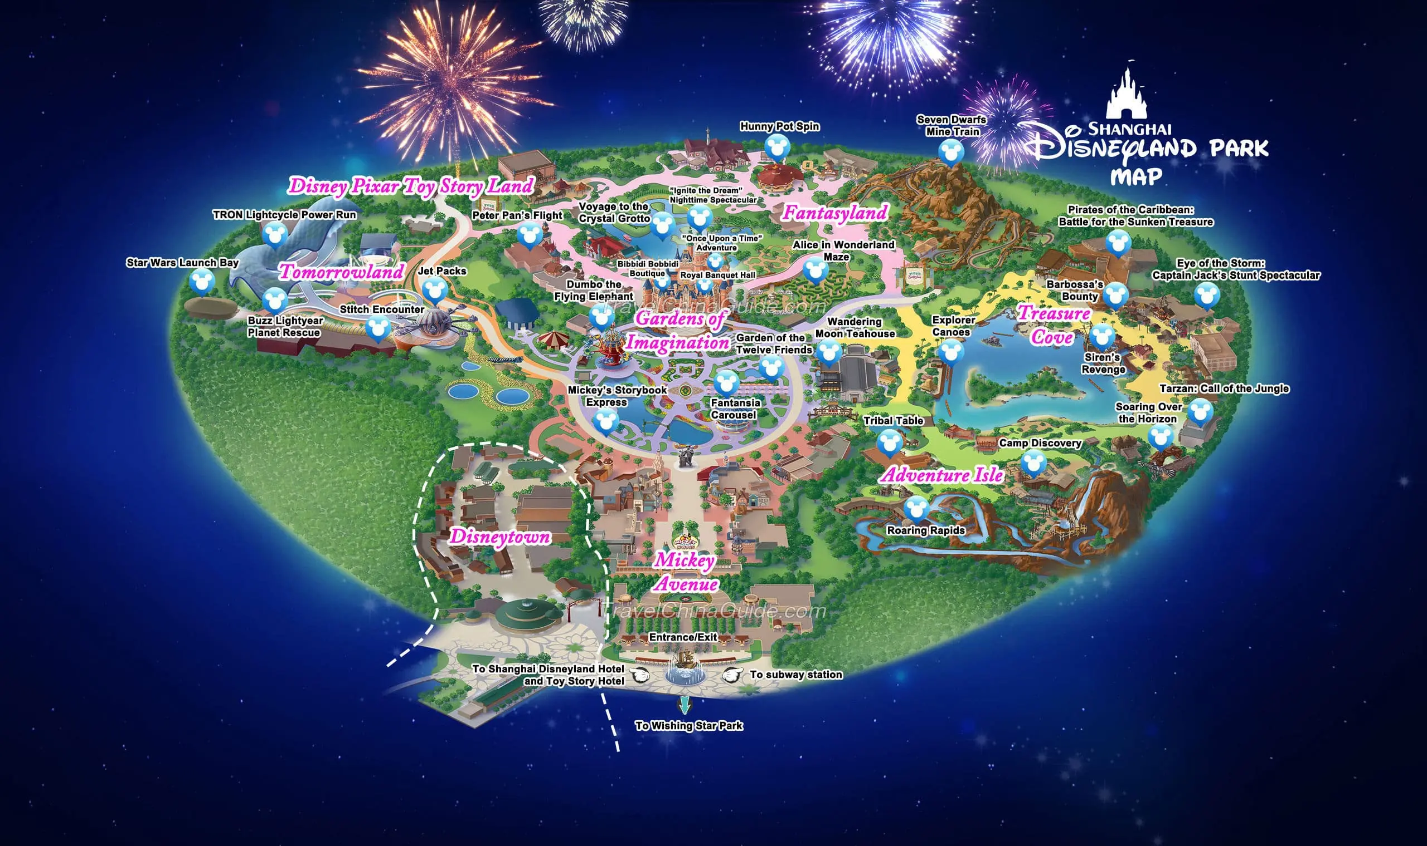
Key characteristics of the servicescape
Physical environment often referred to as the ‘servicescape’
  Facilitates performance or communication of service
Particularly important for tourism & hospitality products
Disney for example effectively uses the servicescape to excite customers
Notes:
Key characteristics of the servicescape
Physical environment often referred to as the ‘servicescape’
Facilitates performance or communication of service
Particularly important for tourism & hospitality products
Universal for example effectively uses the servicescape to excite customers

Slide 5
Elements of the servicescape
Table 8.1

Slide 6
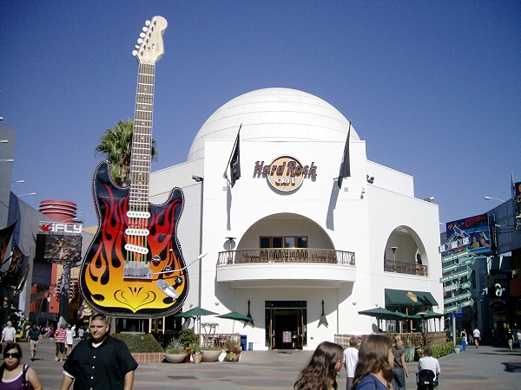
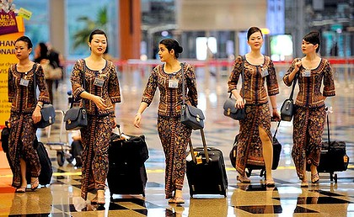
The strategic role of the servicescape
Packaging
  Creates external image
  Sets expectations
Facilitator
  Aids performances of service providers
  Physical layout and functional design
Socializer
  Suggests expected roles, behaviors and relationships
Differentiator
  Distinguished from competitors
  Signals appropriate market segments

Slide 7
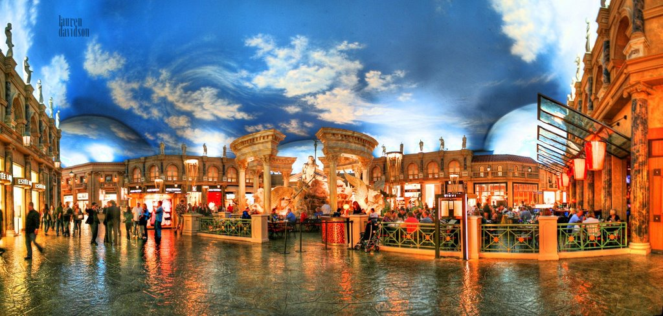
Developing servicescapes
Effective servicescapes:
  Have to be seen holistically
  Everything depends on everything
  e.g. scent and music work together
Themed servicescapes common these days (e.g. Forum Shops)
Interactive servicescapes (e.g. Churchill Museum)
Servicescapes developed to attract new market segments

Slide 8
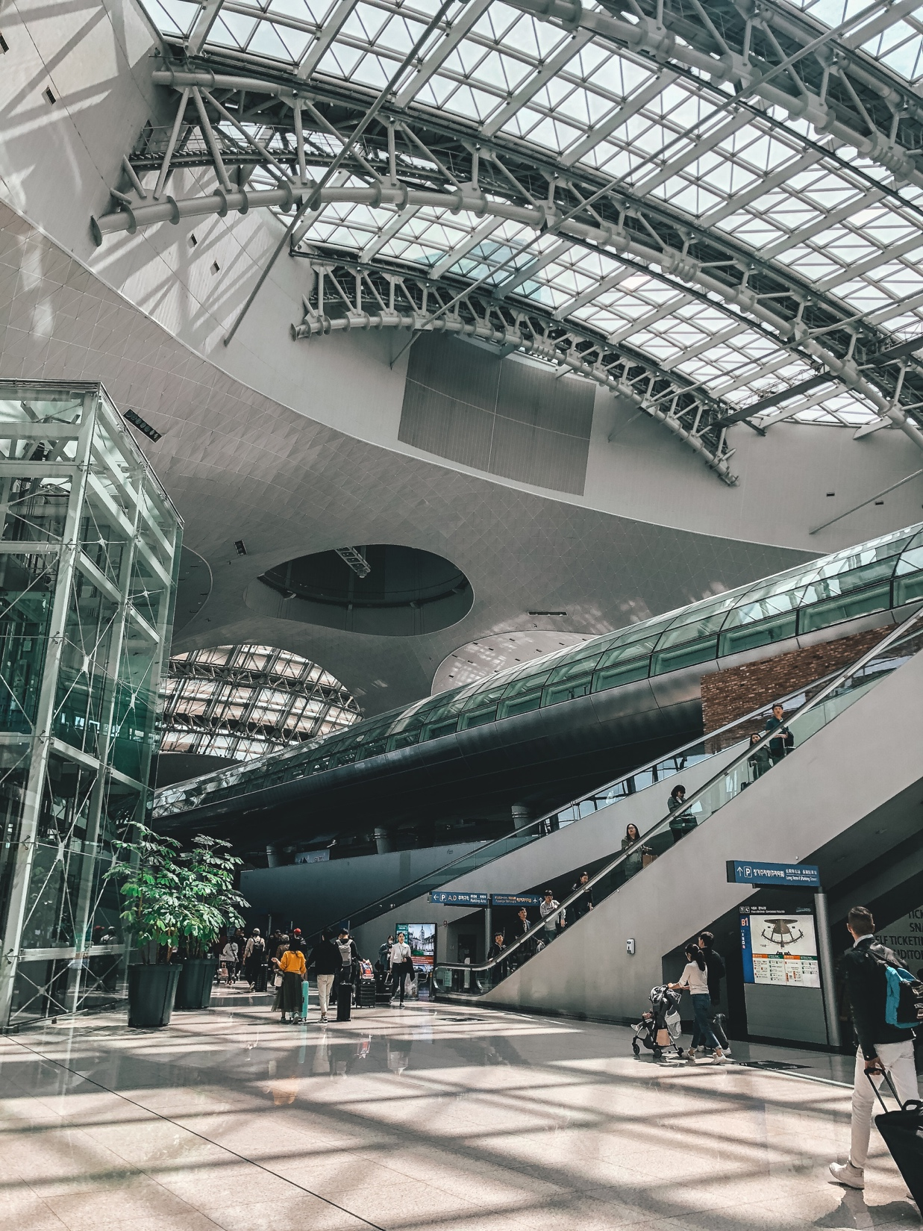
Snapshot:
Incheon Airport, Korea
Customer transit services
  Fast processing times, interactive LCD info screen
  Multi-lingual staff and signage
Customer amenities
  Free internet access, computers, showers, changing rooms
  Between flight tours, golf outings
  Shops, food courts, lounges, cultural centers
Staff training and improvement
  ICAO training center
  Service Improvement Committee
  Incentive program
Technological innovations
  Cooperation and data sharing
  Passenger number forecasting

Slide 9
The effects of servicescapes on consumer behaviour
Customers loyalty incentives:
  High perceived value
  ‘Get’ should exceed ‘Give’
  Rewards for loyalty
Company benefits:
  Higher profits through retaining customers
    More purchases overall
    More frequent purchases
  Lowers operating costs
    No acquisition costs
  Increases company referrals

Slide 10
How the servicescape impacts consumers and employees
Figure 8.1 (Source: Adapted from Bitner, 2002)

Slide 11
Common associations and human responses to colors
Table 8.2 (Source: Based on Lovelock and Wirtz, 2007)

Slide 12
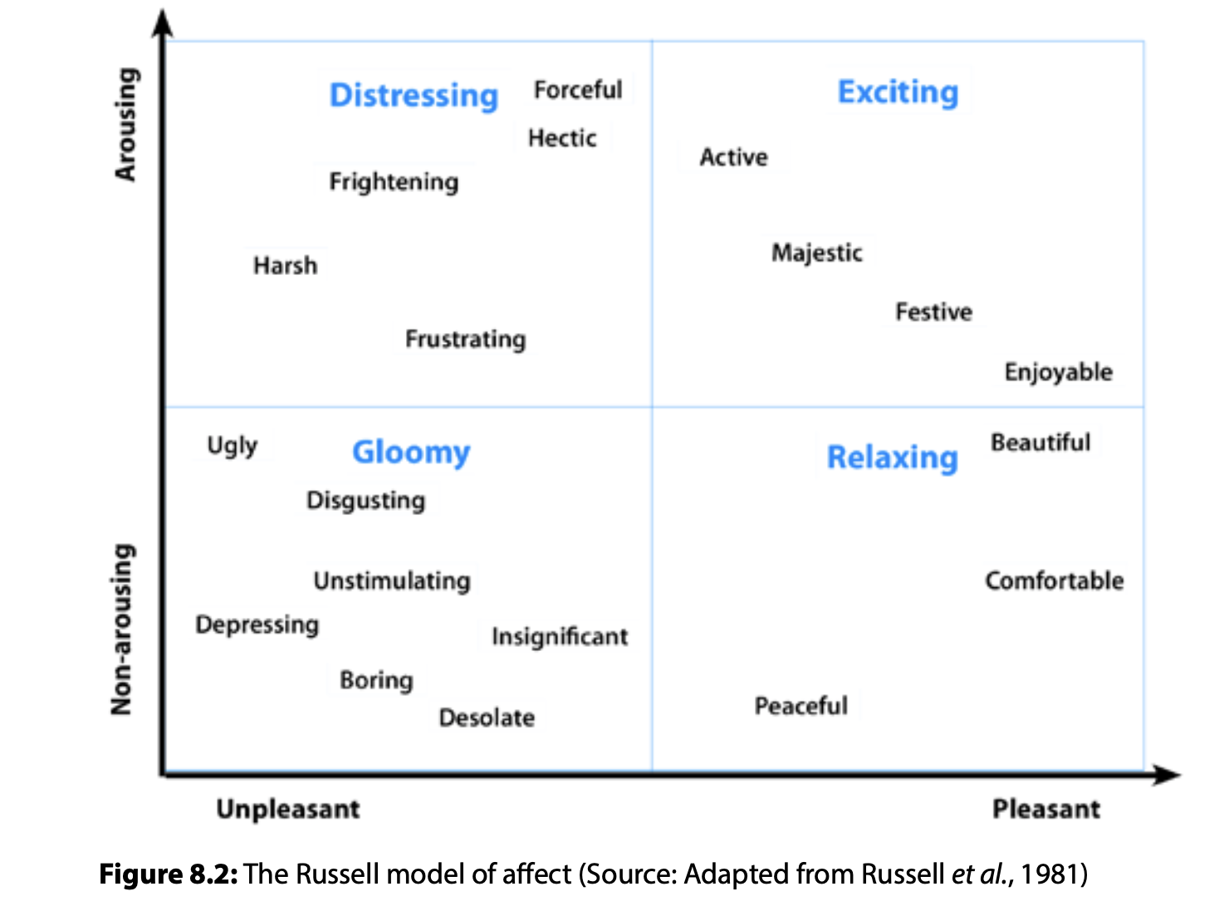

Slide 13
Waiting line strategies – 4 strategies
Employ operational logic
  Streamline operational processes
  Eliminate inefficiencies
  Queue configuration
Establish a reservation system
  Shift demand to time less busy periods
  Inherent problem of ‘no-shows’
    Charge fee
    Overbook capacity
Differentiate waiting customers
  Need-based or customer priority
  Guest registering e.g. FASTPASS
Make waiting time more fun, or at least tolerable

Slide 14
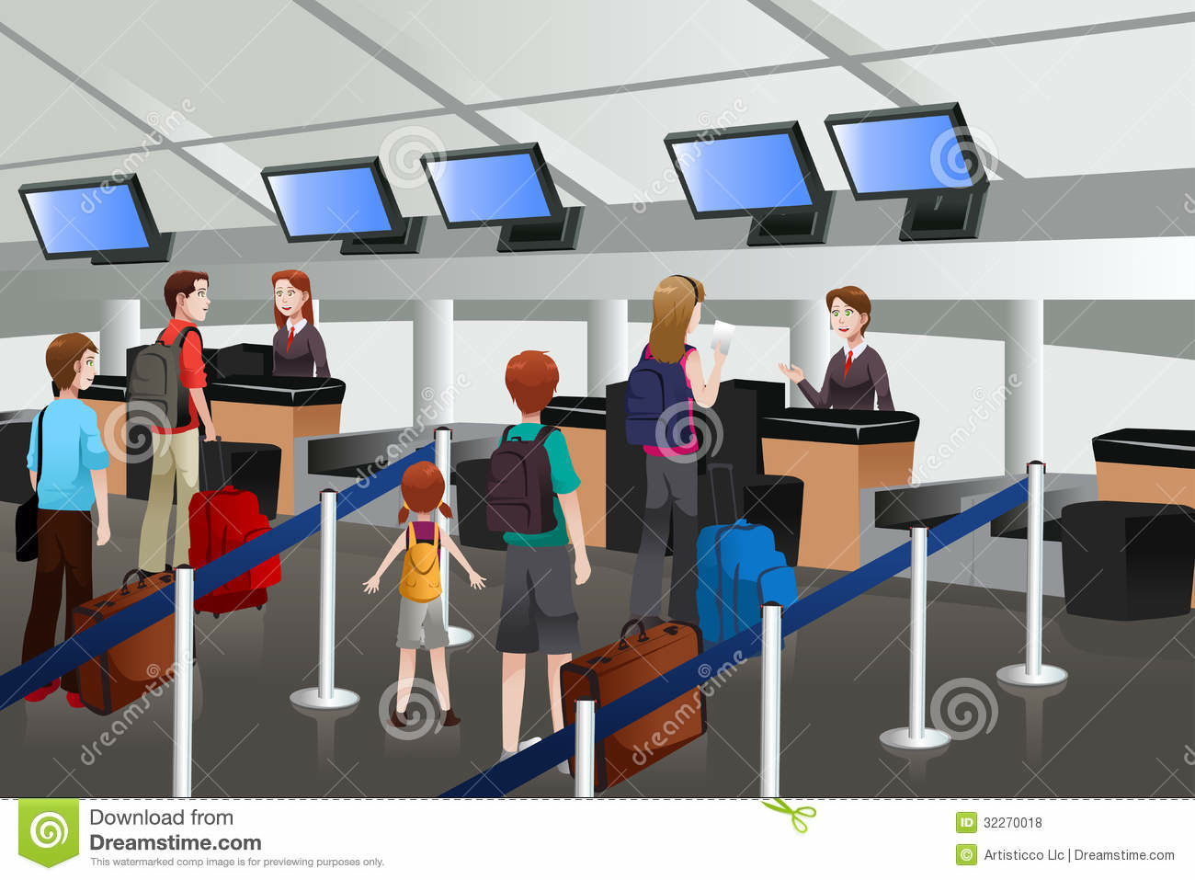
Three possible queue configurations

Slide 15
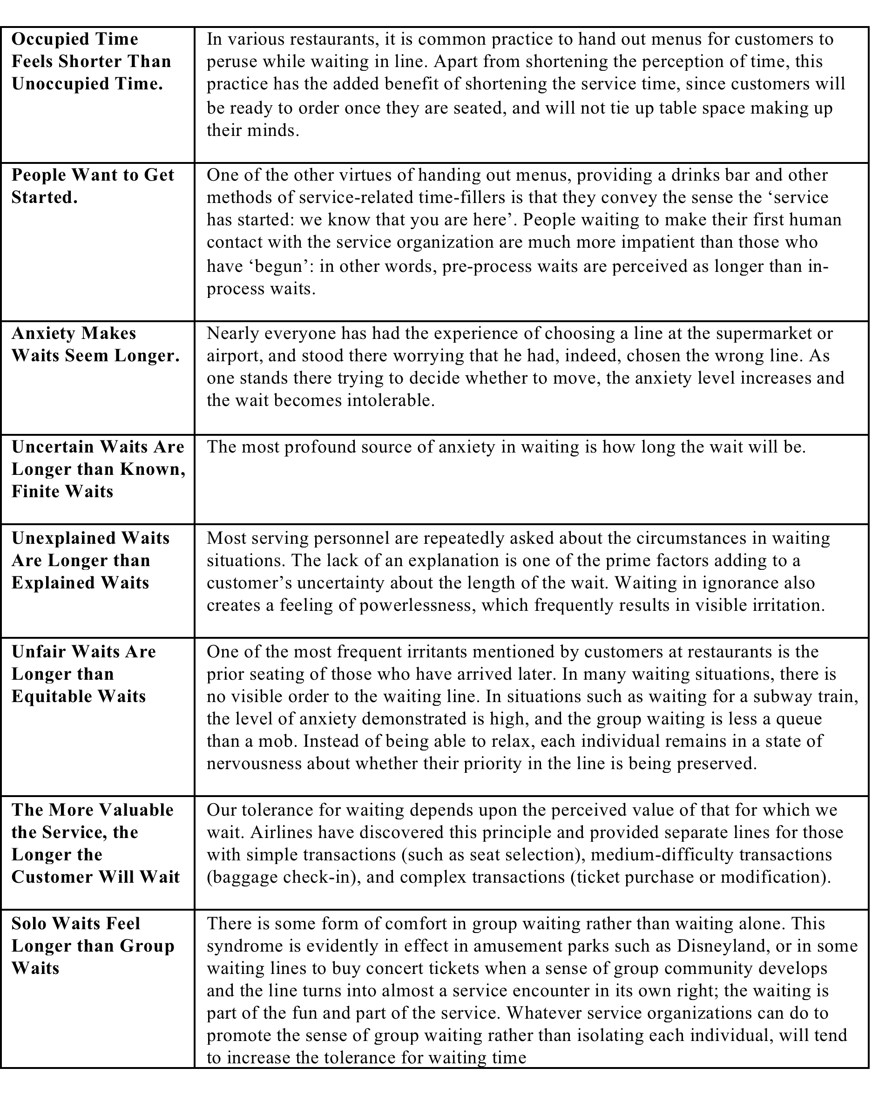
The psychology of waiting lines (Maister)

Slide 16
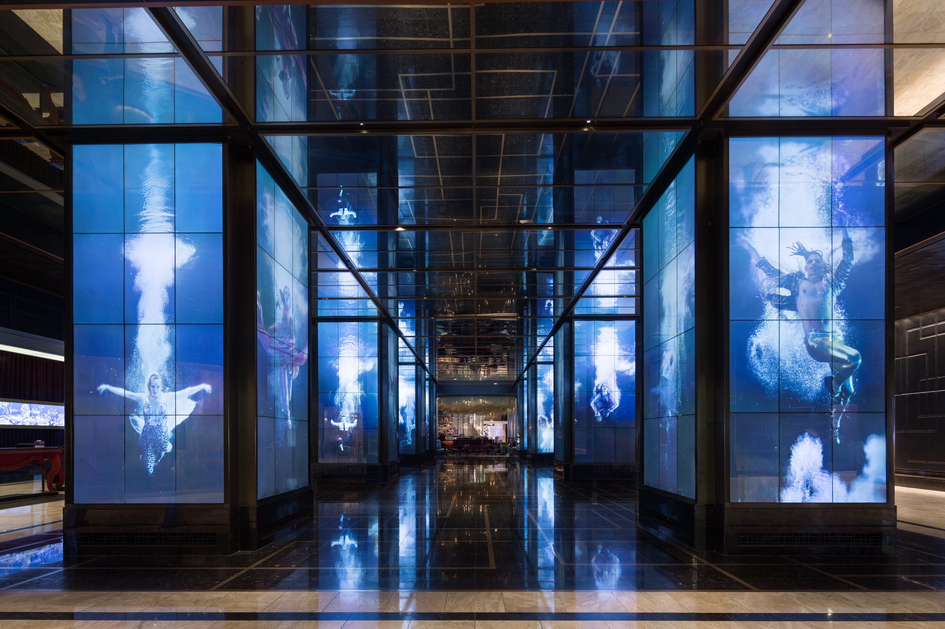
Intelligent Servicescapes
Due to rapid technological advancements, and the use of artificial intelligence (AI) in the hospitality industry, we have seen the emergence in recent years of intelligent or smart servicescapes, which are essentially technology-based servicescapes. A simple example would be the smart hotel room
The COVID-19 pandemic accelerated this trend.
Las Vegas has no shortage of intelligent servicescapes. The hotel lobby of the Las Vegas Cosmopolitan is a good example.

Slide 17
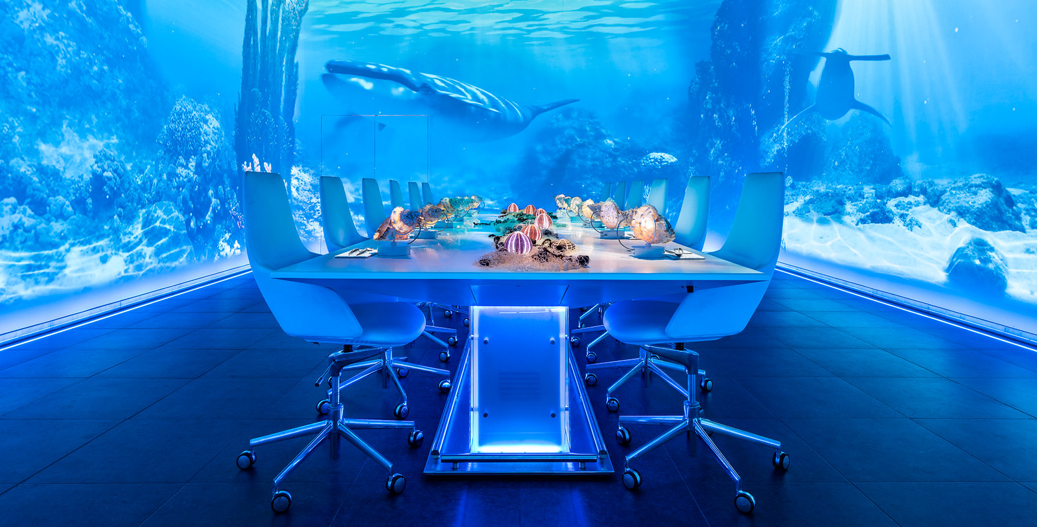
Intelligent Servicescapes
An example of an intelligent servicescape in the restaurant sector is Sublimotion, a futuristic dining concept first introduced on the island of Ibiza in Spain.
Under the helm of double Michelin-starred chef Paco Roncero, this unique dining experience combines food, art, and technology into a novel culinary concept. The dining room consists of one long table surrounded by multimedia panels, while on the walls there are huge digital displays for the projection of vivid images that change depending on the food served.

Slide 18
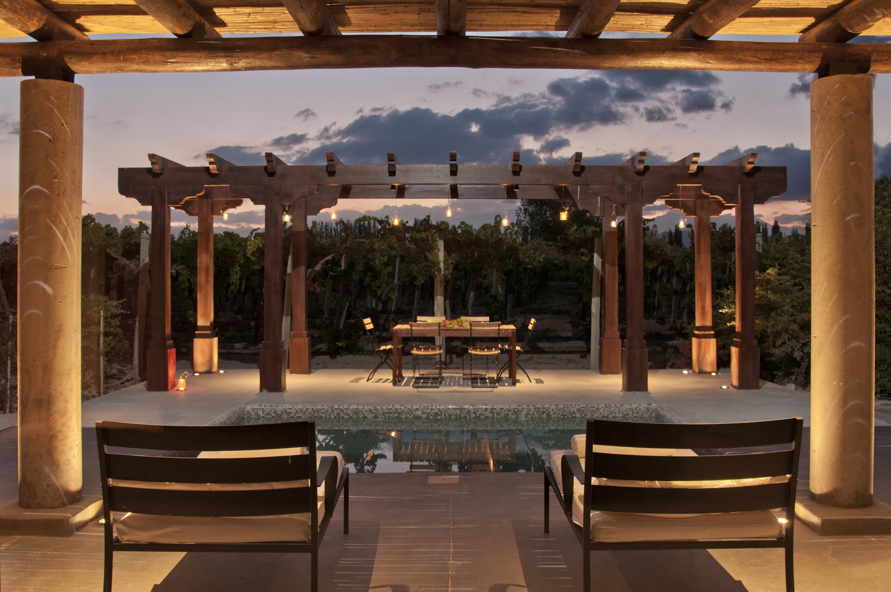
Case Study:
Attention to Detail at Cavas Wine Lodge
We seek the best experience, effortless for our guests.
Exterior design complements landscape
Interior design:
  Unique décor, color schemes
  Mood enhancing music, atmospheric lighting, “clean and fresh” smell
  Hand-selected objects, furniture by local craftsmen, artists
  Regional, organic fruit and vegetables
Customer service
  Staff uniforms
  Frontline service
  Guest expectations
  Surprise events e.g.
  tango evenings
  outdoor cooking lessons

